Slide 1
Discipleship
How to Disciple – Week 2

Slide 2
Practical Tips Getting Started
Make sure the goals are real to you in an experiential way--established in your life, then REPRODUCE that in the life of the disciple.

Slide 3
Practical Tips Getting Started
NEVER forget to have the lesson speak to you FIRST. Failure to do so leads to a FALL.

Slide 4

Point of Reflection
Can you tell someone, “Follow me as I follow Christ?”
Is your life a separated pursuit?

Slide 5
(11) And he gave some, apostles; and some, prophets; and some, evangelists; and some, pastors and teachers; (12) For the perfecting of the saints, for the work of the ministry, for the edifying of the body of Christ: (13) Till we all come in the unity of the faith, and of the knowledge of the Son of God, unto a perfect man, unto the measure of the stature of the fulness of Christ: (14) That we henceforth be no more children, tossed to and fro, and carried about with every wind of doctrine, by the sleight of men, and cunning craftiness, whereby they lie in wait to deceive; (15) But speaking the truth in love, may grow up into him in all things, which is the head, even Christ: (16) From whom the whole body fitly joined together and compacted by that which every joint supplieth, according to the effectual working in the measure of every part, maketh increase of the body unto the edifying of itself in love.
Eph 4:11-16

Slide 6
“Philosophy”
Discipleship is the mission and every member should be a part of it. Make THIS philosophy YOUR philosophy.

Slide 7
Goal 1: Establish the disciple in WORSHIP
The 4 Goals

Slide 8
(23) But the hour cometh, and now is, when the true worshippers shall worship the Father in spirit and in truth: for the Father seeketh such to worship him.
(24) God is a Spirit: and they that worship him must worship him in spirit and in truth.
John 4:23-24

Slide 9
(17) Bow down thine ear, and hear the words of the wise, and apply thine heart unto my knowledge.
(18) For it is a pleasant thing if thou keep them within thee; they shall withal be fitted in thy lips.
(19) That thy trust may be in the LORD, I have made known to thee this day, even to thee.
(20) Have not I written to thee excellent things in counsels and knowledge,
(21) That I might make thee know the certainty of the words of truth; that thou mightest answer the words of truth to them that send unto thee?
Prov 22:17-21

Slide 10
(7) If ye abide in me, and my words abide in you, ye shall ask what ye will, and it shall be done unto you.
(8) Herein is my Father glorified, that ye bear much fruit; so shall ye be my disciples.
John 15:7-8

Slide 11
(1) After this I looked, and, behold, a door was opened in heaven: and the first voice which I heard was as it were of a trumpet talking with me; which said, Come up hither, and I will shew thee things which must be hereafter.
(2) And immediately I was in the spirit: and, behold, a throne was set in heaven, and one sat on the throne.
(3) And he that sat was to look upon like a jasper and a sardine stone: and there was a rainbow round about the throne, in sight like unto an emerald.
(4) And round about the throne were four and twenty seats: and upon the seats I saw four and twenty elders sitting, clothed in white raiment; and they had on their heads crowns of gold.
Rev 4:1-4

Slide 12
Example of a Point of Worship from Lesson One: Salvation
Your entrance into God’s family is through a spiritual birth.
3. You have been adopted into God’s family, and God is your heavenly Father.
“For ye have not received the spirit of bondage again to fear; but ye have received the Spirit of adoption, whereby we cry, Abba, Father.”
– Romans 8:15
4. Now that you are saved, God no longer deals with you as a sinner, but as His child.

Slide 13
Example of a Point of Worship from Lesson One: Salvation
Your entrance into God’s family is through a spiritual birth.
3. You have been adopted into God’s family, and God is your heavenly Father.
“For ye have not received the spirit of bondage again to fear; but ye have received the Spirit of adoption, whereby we cry, Abba, Father.”
– Romans 8:15
4. Now that you are saved, God no longer deals with you as a sinner, but as His child.
“W”

Slide 14
The 2 Thrones
Perhaps a disciple used to hang out with his/her DEALER (Devil’s throne) now they hang out with their DISCIPLER (God’s throne). The CURSER (Devil’s throne) is now in the CHOIR (God’s throne), etc

Slide 15
Goal 2: Establish the disciple in THE WORD
The 4 Goals

Slide 16
Established in the Word:
It gives them the FINAL AUTHORITY to live their life by. The disciple must get his absolute authority from the Word of God. (2 Pe 1:19)
It gives them a way to GROW in Christ. – spiritual food required for spiritual growth.
It keeps them from the DECEPTION of the world around them. (Eph 4:14)

Slide 17
Practical Tips for establishing the disciple in the Word of God:
ACCOUNTABILITY: In discipleship, the key to success is accountability.

Slide 18
Practical Tips for establishing the disciple in the Word of God:
AUTHORITY: The WORD OF GOD must be the disciple’s absolute authority.

Slide 19
Practical Tips for establishing the disciple in the Word of God:
Consider beginning each lesson with a determination to DO what we will learn from the WOG.

Slide 20
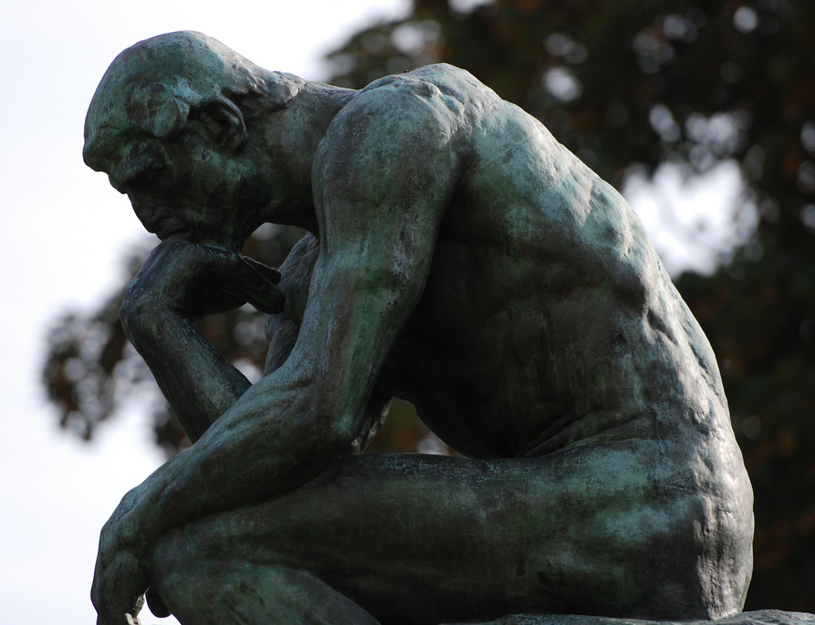
Point of Reflection
Are you established in the Word of God?
If you reproduce you, are there 2 disciples established in the WOG?

Slide 21
Goal 3: Establish the disciple in THE LOCAL CHURCH
The 4 Goals

Slide 22
(24) And let us consider one another to provoke unto love and to good works:
(25) Not forsaking the assembling of ourselves together, as the manner of some is; but exhorting one another: and so much the more, as ye see the day approaching.
Heb. 10:24-25

Slide 23
Goal 3: You are to establish the disciple in the LOCAL CHURCH (Heb. 10:24-25).
The Lord Jesus established a body of people to function as ONE. Jn 17:11, 18-26
It gives them an IDENTITY in the Body of Christ. (1 Co 12:27)
It gives them a place to GROW. (Eph 4:11-16)
It provides them with ACCOUNTABILITY. (Rom 15:14)
It provides them with a place and structure to be EQUIPPED for ministry! (Eph 4:16)

Slide 24
Practical tips for establishing the disciple in the local church:
The disciple must have a VEHICLE or STRUCTURE to work out God’s plan for this life. God’s ordained structure is the local church.

Slide 25

Point of Reflection
Where are you?
Are you submitted to the structure of the local church?

Slide 26
Goal 4: Establish the disciple in MINISTRY
The 4 Goals

Slide 27
Goal 4: Established in Ministry
It includes them in our God-given MISSION.
It brings them to the place where they can ­REPRODUCE.

Slide 28

Reflection: First:
Are you established in ministry?

Slide 29
Goal 4: Established in Ministry
Your job is not complete until your disciple has begun an active INVOLVEMENT/PARTICIPATION in the work of Jesus Christ.

Slide 30
Goal 4: Established in Ministry
Take note of this underlying concept you as mentor and disciple must understand: A disciple must TAKE UP HIS CROSS.

Slide 31
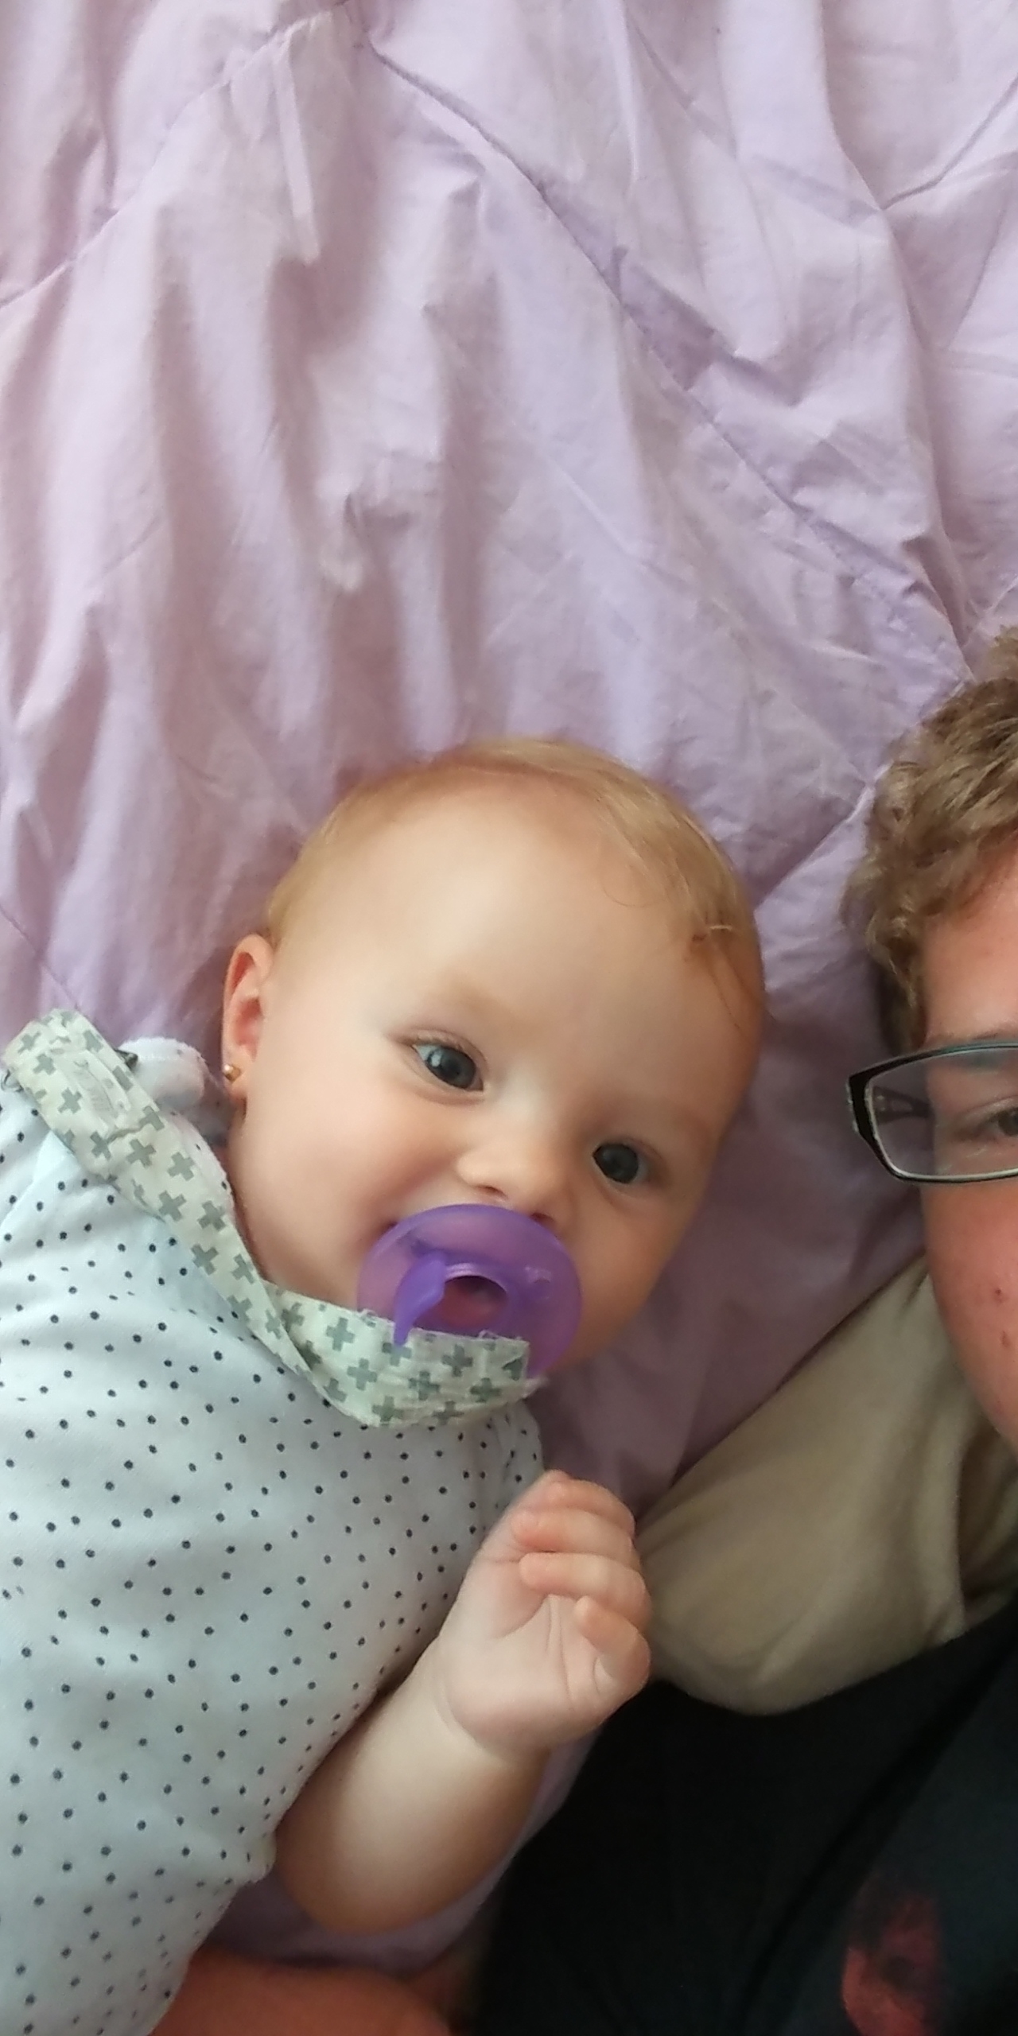
Random Cute Baby with Uncle Jonathan photo
Sorry, Grandpa moment.

Slide 32
Thou art worthy, O Lord, to receive glory and honour and power: for thou hast created all things, and for thy pleasure they are and were created.
Rev. 4:11

